Slide 1
SAP UI5 – Intermediate Level

Slide 2
UI5I-OVW-02 : Lifecycle hooks of View

Slide 3
Lifecycle Hooks:
onInit(): Called when a view is instantiated and its controls (if available) have already been created; used to modify the view before it is displayed to bind event handlers and do other one-time initialization
onExit(): Called when the view is destroyed; used to free resources and finalize activities

Slide 4
Lifecycle Hooks:
onAfterRendering(): Called when the view has been rendered and, therefore, its HTML is part of the document; used to do post-rendering manipulations of the HTML. SAPUI5 controls get this hook after being rendered.
onBeforeRendering(): Invoked before the controller view is re-rendered and not before the first rendering; use onInit() for invoking the hook before the first rendering

Slide 5
UI5I-OVW-03 : Concept of Component.js file

Slide 6
Component.js
The Component.js file is the component controller and provides the runtime metadata and the component methods.
A component controller is defined with the asynchronous module definition (AMD) syntax. In the sap.ui.define statement; the required dependencies can be declared which can be used in the controller.
To create an SAPUI5 component, you extend either the Component or UIComponent base class and pass the name of the module (namespace + .Component).

Slide 7
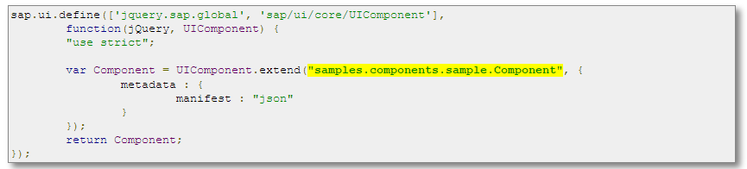
Component.js

Slide 8
UI5I-OVW-04 : Creating Simple UI5 Apps - exercise

Slide 9
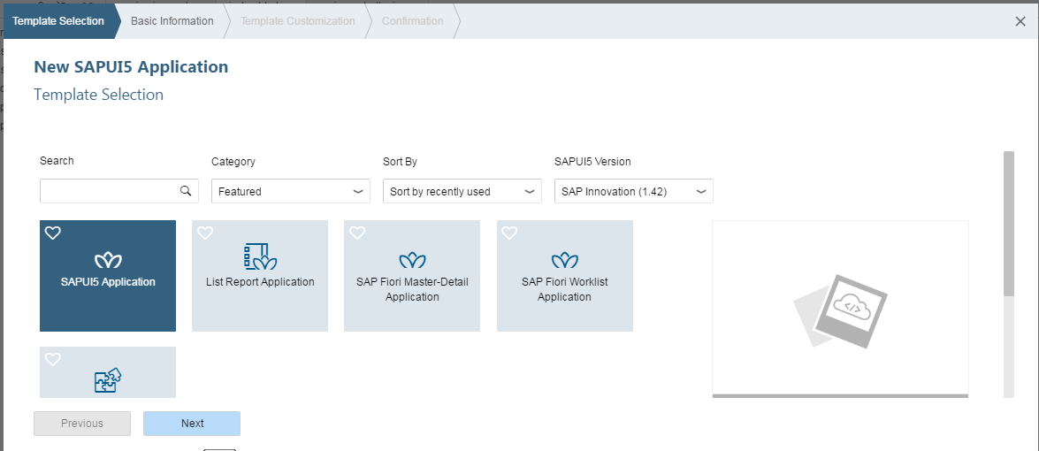
Hello world

Slide 10
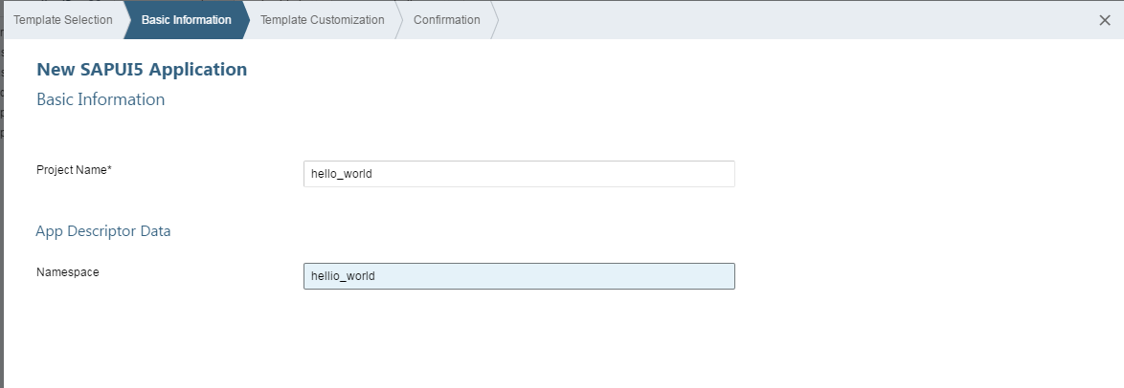
Hello world

Slide 11
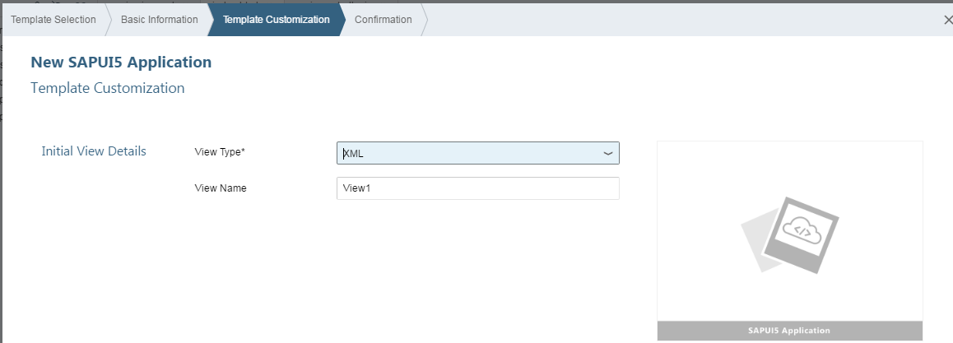
Hello world

Slide 12
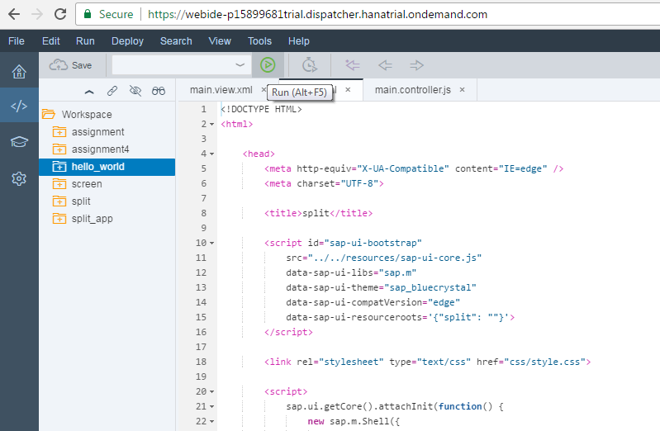
Hello world

Slide 13
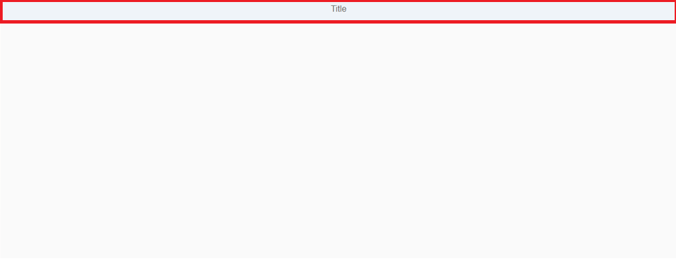
Output of Hello world

Slide 14
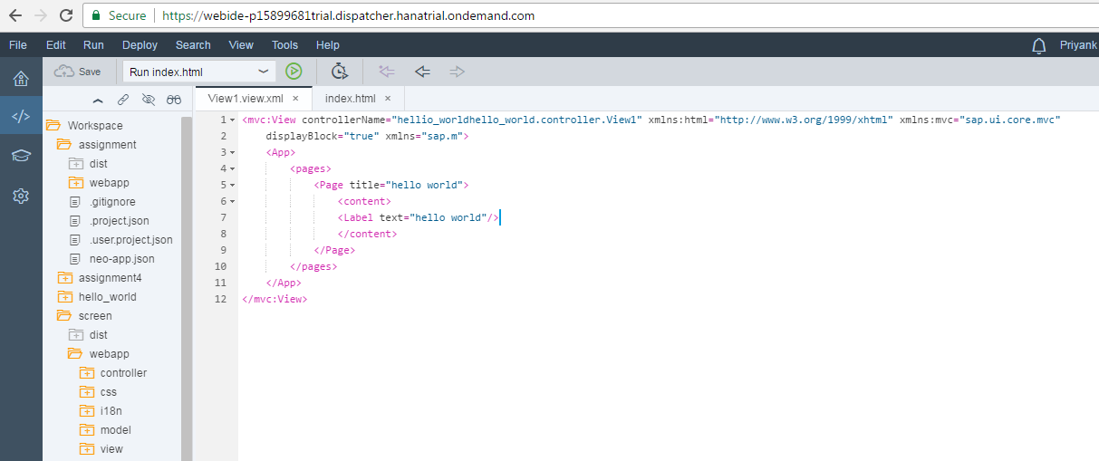
Hello world

Slide 15
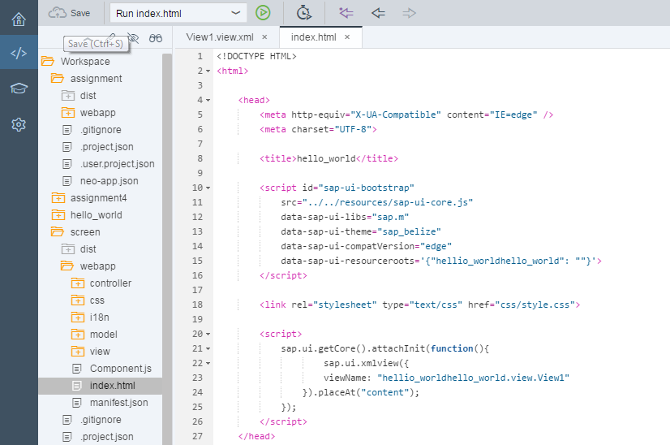
Hello world

Slide 16
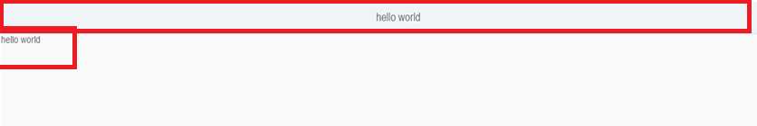
Output of Hello world

Slide 17
Useful links
SAP UI5 Demo kit- https://sapui5.hana.ondemand.com/sdk/#content/Controls/index.html
SCN Community page- http://scn.sap.com/community/developer-center/front-end
SAP UI5 testsuite- https://sapui5.hana.ondemand.com/sdk/test-resources/testsuite/testframe.html
Creating SAP UI5 Project http://scn.sap.com/docs/DOC-37805

Slide 18

Questions???

Slide 19


